Slide 1
DETECT PIXELATED IMAGE AND CORRECT IT
Prepared by:
Divyang Jain
Guided by:
Prof. Piyush Mali

Slide 2
Problem Statement
Creating a robust system that can detect pixelated/bad quality images and can make specific corrections wherever needed, which is suitable for both professional and personal use.

Slide 3
Unique Idea Brief (Solution)
Pixelation in images occurs when low-resolution images are enlarged.
This results in blocky and distorted visuals that degrade overall quality of te image.
Here, the challenge is to develop a robust algorithm that can automatically detect pixelation in images and then apply necessary corrections to enhance the image’s clarity and accuracy.
This is done by using various Correction Techniques:
Super-Resolution Methods
Edge Enhancement
Texture Synthesis
And Quality Assessment Metrics:
PSNR
SSIM
Perceptual Metrics

Slide 4
Features Offered
Detection of Pixelation
Correction of Pixelated Regions
Scalability and Efficiency
Quality Assessment
Machine Learning Models
Real-Time Capabilities
Adaptability and Versatility
Robustness

Slide 5
Process flow
Image Input
Preprocessing
Pixelation Detection
Correction Techniques
Quality Assessment
Output
Real-time Considerations
Iteration and Optimization
Integration

Slide 6
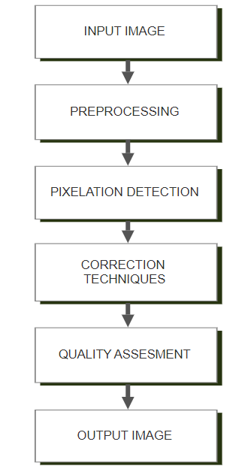
Architecture Diagram

Slide 7
Technologies used
Python (Programming Language)
Modules used:
OpenCV
Numpy
Tenserflow
Keras

Slide 8
Team members and contribution:
Team Member:
- Role: It is a solo project created for the completion of Intel Unnati Industrial Training Program.
Contributions:
1. Improving Image Quality: Develop algorithms to spot pixelation and blur in images and make them look better.
2. Enhancing Techniques: Create methods to clear up pixelated images and sharpen blurry ones.
3. Using Advanced Tech: Apply CNNs to make images even clearer and more detailed.
4. Checking Results: Measure how much better images look using tools like PSNR and SSIM.
5. Keeping Records: Write down details of how algorithms work and what they achieve.
6. Testing and Using: Make sure algorithms work with different images and can be used easily.

Slide 9
Conclusion
The process of detecting and correcting pixelated images is a crucial task that involves advanced techniques in image processing and machine learning. By following a systematic approach, we can effectively enhance the visual quality of images impacted by pixelation.
In essence, detecting and correcting pixelated images is not just about technical improvement but also about enhancing user satisfaction and enabling more effective utilization of images in various applications. By leveraging cutting-edge technologies and methodologies, we can continue to push the boundaries of image quality enhancement beyond par in the digital age.

Slide 10
THANK YOU

